Slide 1

The Business Analytics Club
Presents…
the
Predictions Competition

Slide 2
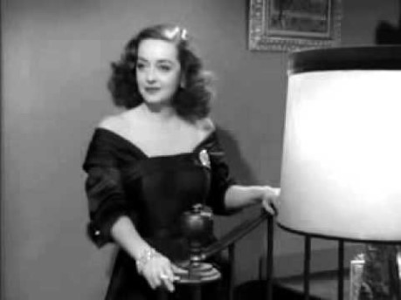

Slide 3
“Fasten your seatbelts. It’s going to be a bumpy night.”
Competition Ground Rules
How would you predict the Oscars?
How some experts would predict the Oscars
Facilitated web scraping
Web scraping with R
Cleaning data with R
Modeling with R
Other possible models
Notes:
https://www.youtube.com/watch?v=yKHUGvde7KU

Slide 4


Slide 5
“Am I the only who gives a **** about the rules!”
Objective: Predict the winners of the following eight Academy Awards plus one wild card category of your choosing
Best Picture
Best Director
Best Actor
Best Actress
You may enter as a team or as individual
You may use any method you like
The entrants with the most correct predictions will win $250 to be shared among the winning entrants
Best Original Screenplay
Best Adapted Screenplay
Best Supporting Actor
Best Supporting Actress
Notes:
https://www.youtube.com/watch?v=-z0Pm7tccvc

Slide 6
“Am I the only who gives a **** about the rules!”
Key Dates
Friday, January 31: Kickoff / Training Session
Tuesday, February 4: Check-In Meeting
Sunday, February 9: Submission Deadline at noon ET
Sunday, February 9: Academy Awards at 8pm ET
What to submit:
A csv file with two columns:
Award Name
Predicted Winner
A brief write-up (in email, Word, whatever) explaining your methodology
Submit to baclub@nd.edu

Slide 7
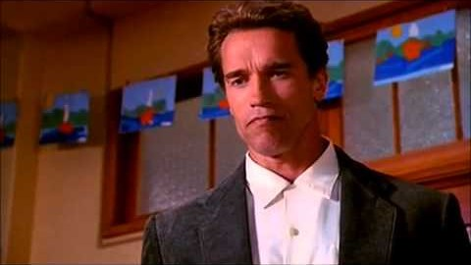

Slide 8
“I’m going to ask you a bunch of questions, and I want to them answered immediately.”
How would you predict Oscar winners?
Notes:
https://www.youtube.com/watch?v=w3sLzmmejCA
What are some potential predictors?

Slide 9
“I’m going to ask you a bunch of questions, and I want to them answered immediately.”
What data would you need?
Notes:
Where could you find the data?
How would you collect it?

Slide 10
Ideas We Came Up With..
Previous nominations/wins
Critical response
Box office results
Aggregated reviews (Rotten Tomatoes)
Other award shows
Ad/Marketing spending
Google search history
Plot / genre
Production company
Eccentric character / body transformation
Notes:
Where could you find the data?
How would you collect it?

Slide 11
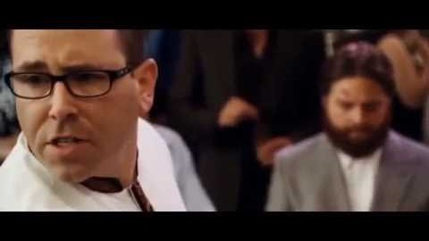
Notes:
https://youtu.be/DVw_RPUrc4g?t=68

Slide 12
Method 1: The Google News Model
Developed by Burak Tekin
Hypothesis:
The more the press is buzzing about a film/star/director, the more likely it is to win an Oscar.
Method:
Search for [Nominee name] and “Oscars” (add character’s name for actors)
Count the number results
Where/how to collect the data:
Google Trends Search
Google News Search

Slide 13

Method 1: The Google News Model
Google Trends Search
Navigate to https://trends.google.com/
Search for [Nominee name] and “Oscars” (add character’s name for actors)
You can search five terms at a time (perfect for everything except Best Picture!)
Adjust time filter, search type, categories, etc. as you see fit
Use the facilitated download button and save the files somewhere accessible
Sample
Notes:
https://trends.google.com/trends/explore?geo=US&q=Martin%20Scorsese%20Oscars,Bong%20Joon%20Ho%20Oscars,Quentin%20Tarantino%20Oscars,Sam%20Mendes%20Oscars,Todd%20Phillips%20Oscars

Slide 14
Method 1: The Google News Model
Google News Search
DON’T navigate to news.google.com (doesn’t yield result count)
Go to https://www.google.com/, run a search, and then switch to “News”
Search for [Nominee name] and “Oscars” (add character’s name for actors)
Copy, paste the number of results into a csv
Sample 1
Sample 2
Notes:
https://www.google.com/search?&tbm=nws&q=joaquin+phoenix+arthur+fleck+Oscars
https://www.google.com/search?&tbm=nws&q=leonardo+dicaprio+rick+dalton+oscars

Slide 15
OR…

Slide 16
Method 1: The Google News Model
Google News Search
Create a csv with each nominee’s name (and actor’s character)
Create the URL for each search you need to run:
Sample: https://www.google.com/search?&tbm=nws&q=joaquin+phoenix+arthur+fleck+Oscars
Part 1: https://www.google.com/search?&tbm=nws&q=
Part 2: Actor’s name with spaces replaced by +
Part 3: +
Part 4: Character’s name with spaces replaced by +
Part 5: +Oscars
Loop through those pages and “scrape” the results element
Notes:
https://www.google.com/search?&tbm=nws&q=joaquin+phoenix+arthur+fleck+Oscars
https://www.google.com/search?&tbm=nws&q=leonardo+dicaprio+rick+dalton+oscars

Slide 17
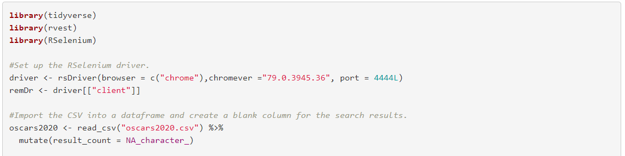
Method 1: The Google News Model
Google News Search
Code: https://github.com/saberry/ac_Oscars/blob/master/Oscars_Predictions_Walkthrough.html

Slide 18
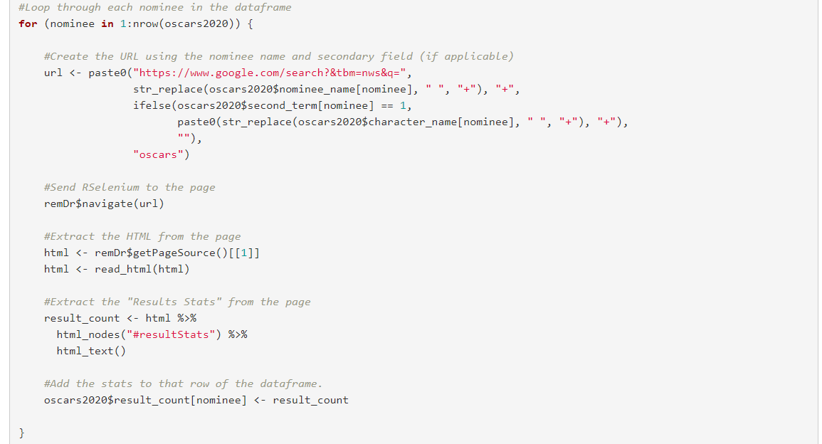
Method 1: The Google News Model
Google News Search
Code:

Slide 19
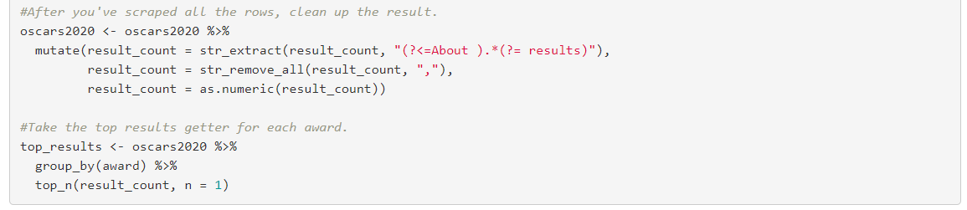
Method 1: The Google News Model
Google News Search
Code:

Slide 20
Method 2: The 538 Model
Developed by Walt Hickey
Hypothesis:
Other awards shows (Golden Globes, SAG, DGA, etc.) are like polls. Certain award shows may signal frontrunners for certain categories.
Method:
Take each preceding award show for the last 25 years
Calculate the % of years that award show accurately predicted each category.
Square the percentage
If the show represents an "insider" show (producers guild, etc.), double the score
Add up the scores for each film in each category
Highest score wins
Where/how to collect the data:
IMDb has pages for most major awards

Slide 21
Method 2: The 538 Model
Let’s go to the code…

Slide 22
Other Models
Aggregate Predictions
Box Office and Rotten Tomatoes
IMDB has box office numbers and Metascore data
Betting Markets
https://www.oddsshark.com/entertainment/academy-awards-oscars-betting-odds

Slide 23
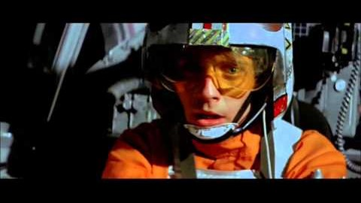

Slide 24
May the force be with you…
Key Dates
Friday, January 31: Kickoff / Training Session
Tuesday, February 4: Check-In Meeting
Sunday, February 9: Submission Deadline at noon ET
Sunday, February 9: Academy Awards at 8pm ET
What to submit:
A csv file with two columns:
Award Name
Predicted Winner
A brief write-up (in email, Word, whatever) explaining your methodology
Submit to baclub@nd.edu

